Slide 1
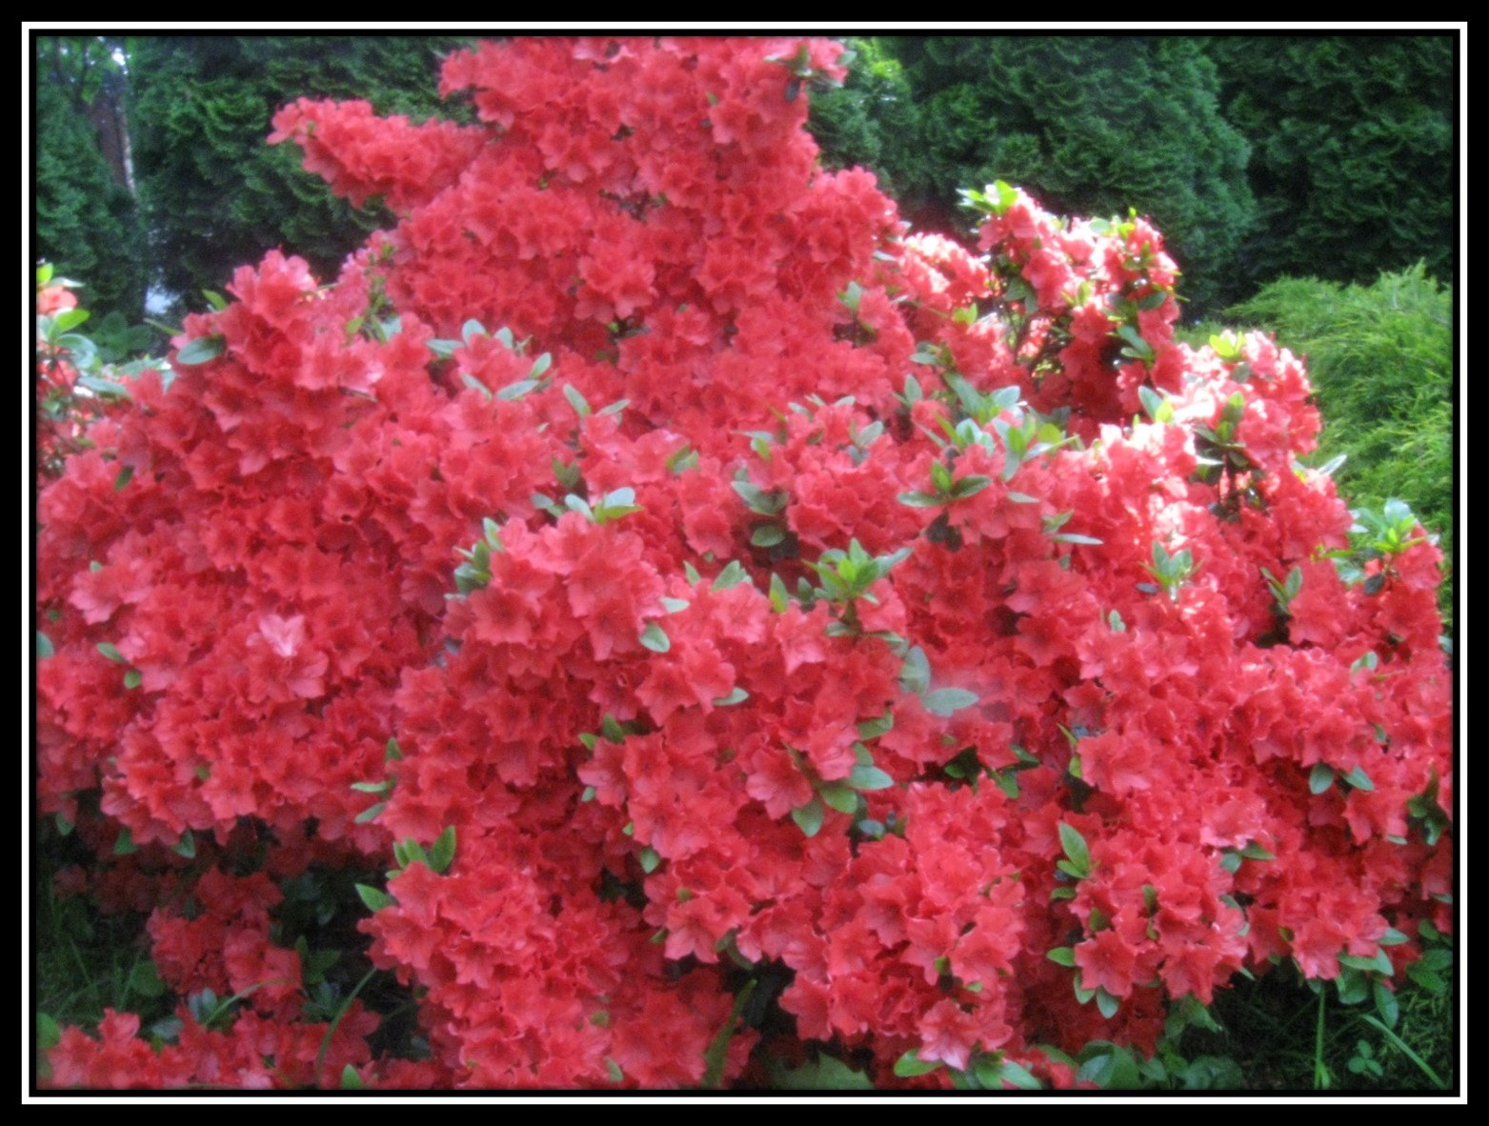
NATURE
PICTURE DICTIONARY

Slide 2
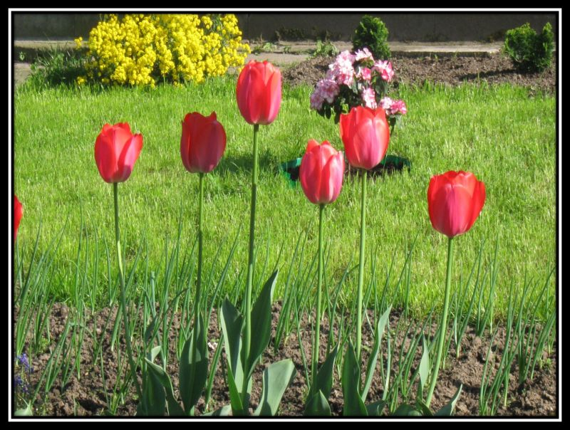
FLOWERS
GRASS
TULIPS
SPRING

Slide 3
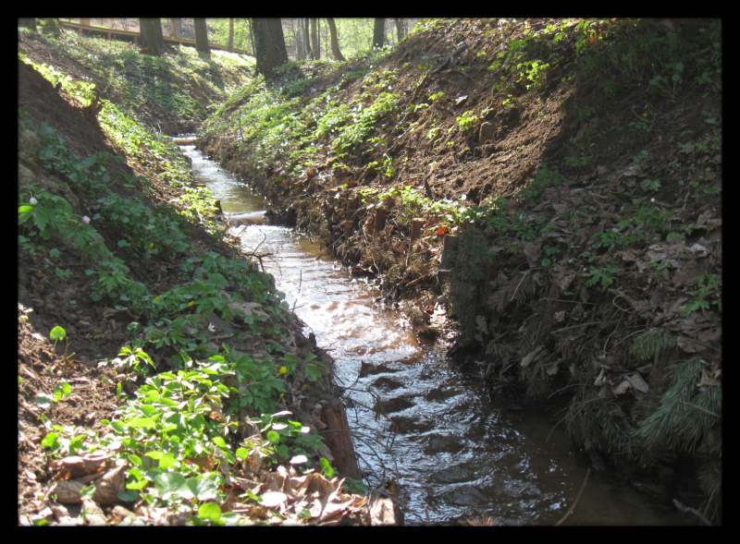
WATER
CREEPER
STREAM

Slide 4
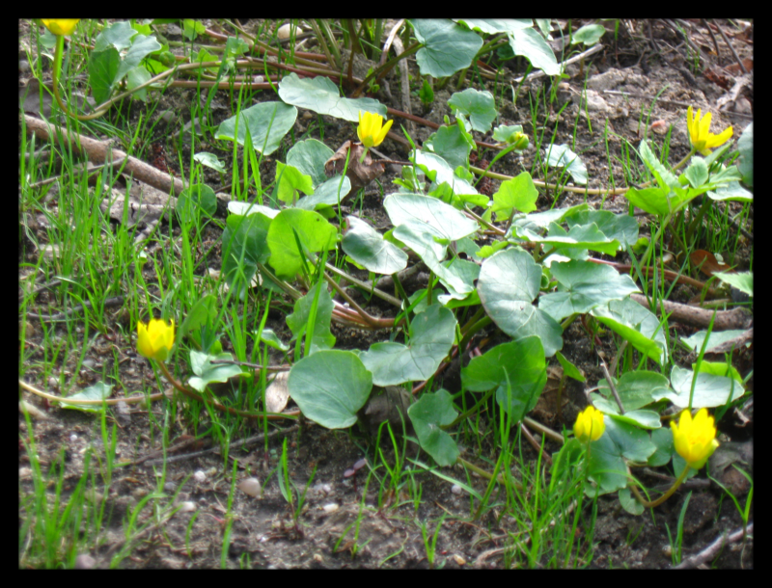
LEAF / LEAVES
BLADE
ground / soil

Slide 5
SKY
RAINBOW
TREES

Slide 6
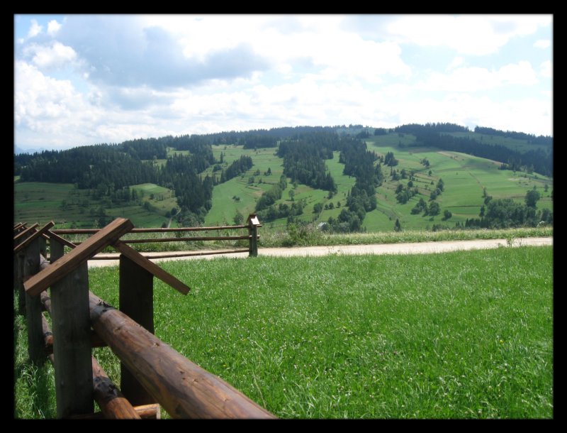
PLANTS
MEADOW

Slide 7
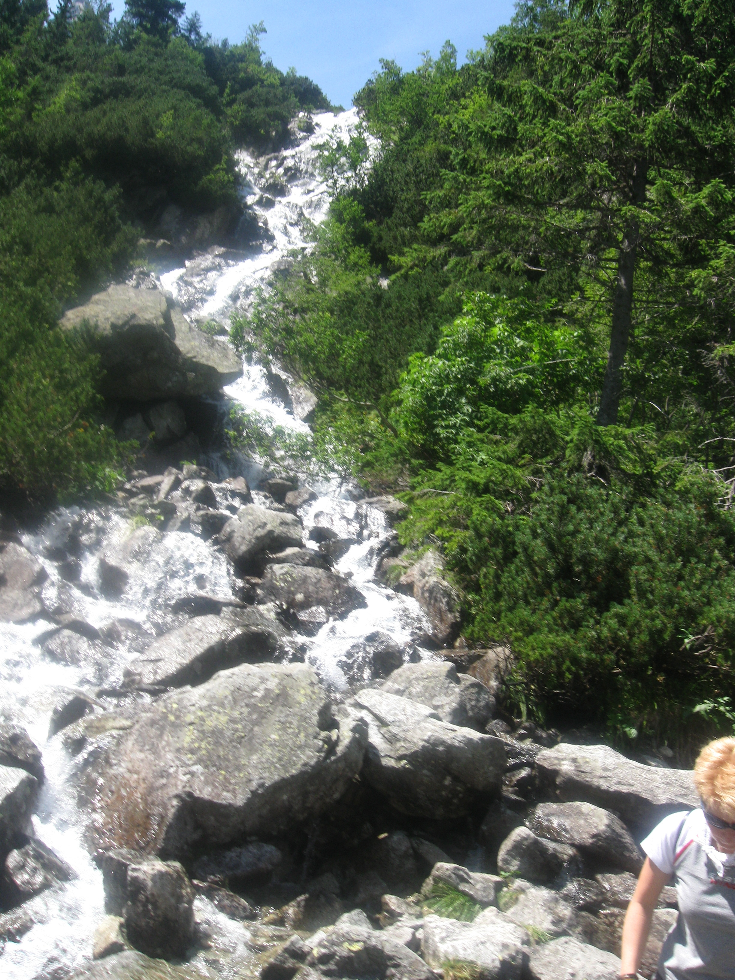
WATERFALL
ROCKS

Slide 8
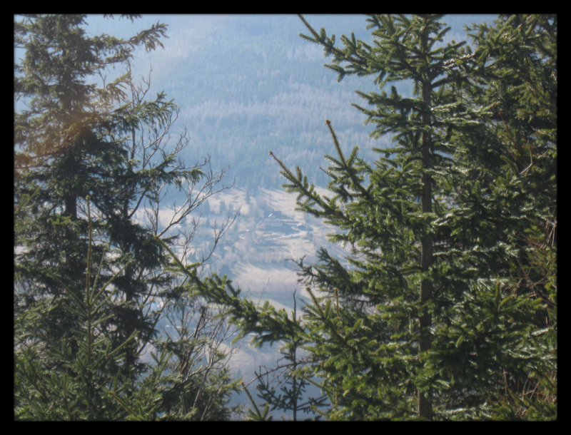
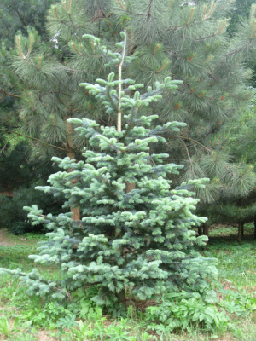
PINE TREE
SPRUCE

Slide 9
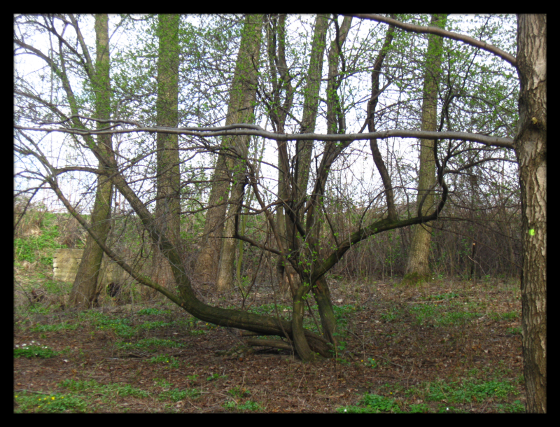
TREES
BRANCH
FOREST
SPRING
UNDERGROWTH

Slide 10
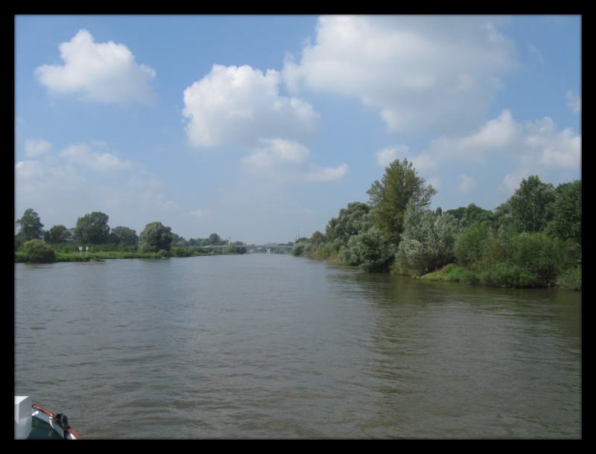
BUSHES
RIVER BANK
RIVER

Slide 11
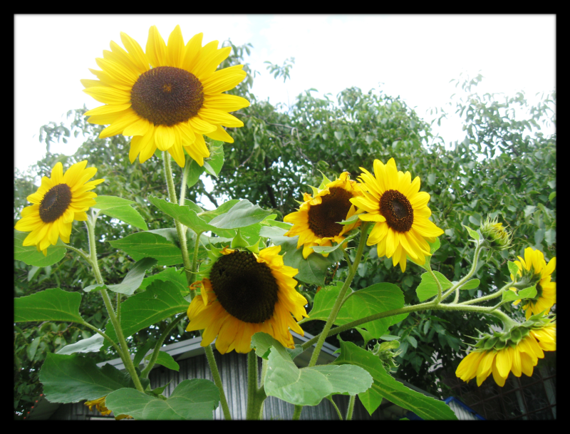
SUNFLOWERS
SUMMER

